Slide 1
Marketing Insights into Catalog Data
PRESENTED BY: Hanson wu
Medha Tiwary
Jaahnavi Tiruthani
animesh kansal

Slide 2
Overview
Introduction
Data Manipulation and New Variables
Exploratory Analysis
Ideas
Insights

Slide 3
Introduction
Catalog dataset focuses on several aspects of sales in products
Census data from 50 states was used to find marketing insights
Merging multiple datasets led to more conclusive answers
Exploration led to elimination of certain fields

Slide 4
Data manipulation
GPR was identified as the target variable
New variable: NGPR or Net GPR was created to understand the net revenue without shipping, handling and sales tax amounts
Analysis of each household would be inconclusive
So SumNGPR was created to aggregate value of NGPR per zipcode
Gender, household type and income was included in the final dataset

Slide 5
Dropped Variables
Shipping and Handling
Sales Tax
Cancel Amount
Returned Amount
Refund Amount
Gift Certificate Amount
Coupon Amount
Refund Status Code
Refund Reason
Offer Drop Code
Additional Charges Amount
Write Off Amount

Slide 6
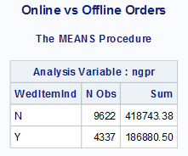
Exploratory Analysis: Initial Parameter Testing
What are the main methods people are spending money on the catalogue?
Despite the changes in the advertising methods
Conclusive enough to keep the focus on offline method i.e. catalog

Slide 7
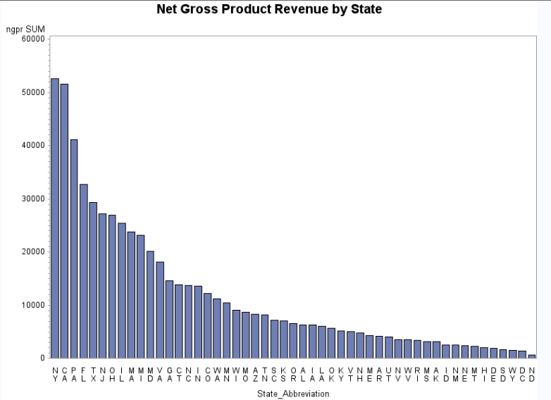
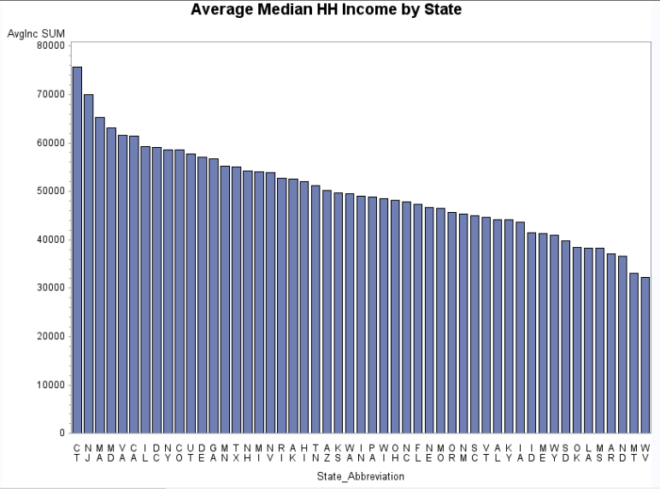
Exploratory Analysis: Initial Parameter Testing
Which zip codes or states spend the most money? Which make the most money?
The states with high average median household income are not the ones with the higher Net Gross Product Revenue
NGPR highest in states with large populations

Slide 8
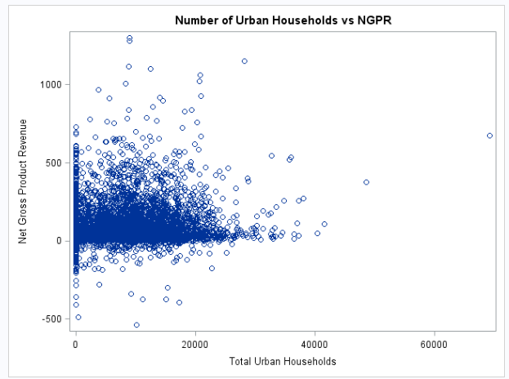
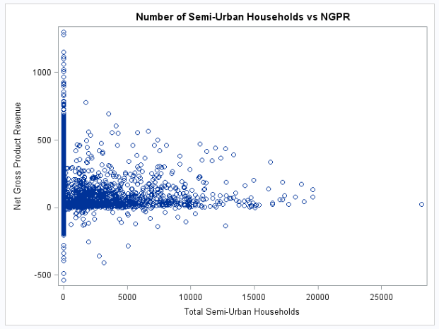
Exploratory Analysis: Urban vs Semi-Urban
Urban population contributes more to NGPR

Slide 9
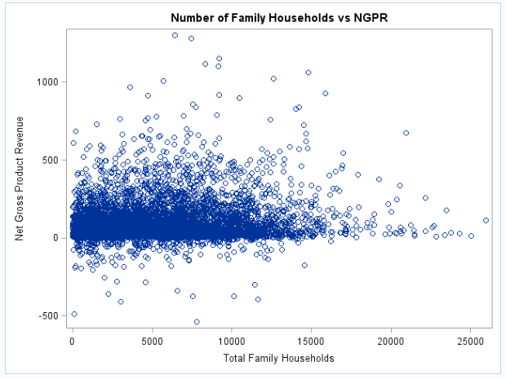
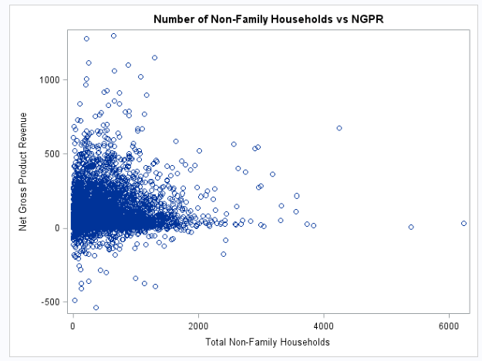
Exploratory Analysis: type of household
No clear correlation

Slide 10
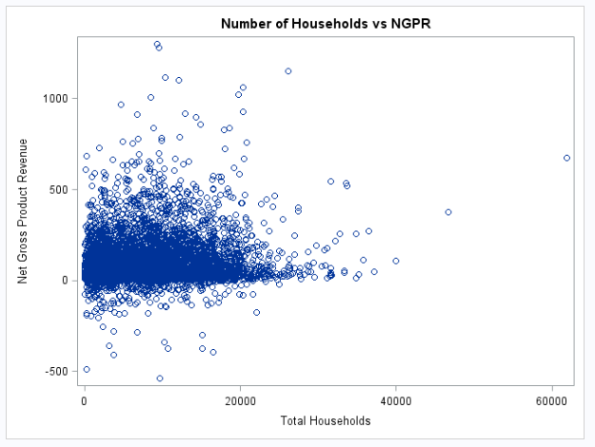
Exploratory Analysis: Household Number
Total number of households vs NetGPR (NGPR)
Relationship should be explored to understand the better allocation of marketing techniques
More potential for the catalog advertising to reach higher number of people in densely populated areas
Resources used for reaching customers → highly optimized if densely populated areas are focused

Slide 11
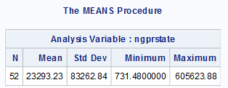
Idea 1: Target States with higher NGPR
States with higher NGPR could be targeted for more success in sales conversion
New York, California, Pennsylvania, Florida, Texas, New Jersey, Ohio, Illinois, Massachusetts, and Michigan: states that can be targeted for more advertising

Slide 12
Idea 2: Encourage more Offline Online Orders
H₀: There is no significant difference in how much people spend online vs offline.
H_{A}: There is a difference between how much people spend online vs offline.
T-test confirms that people tend to order more from offline resources.
Concentration should be more on resources to advertise offline

Slide 13
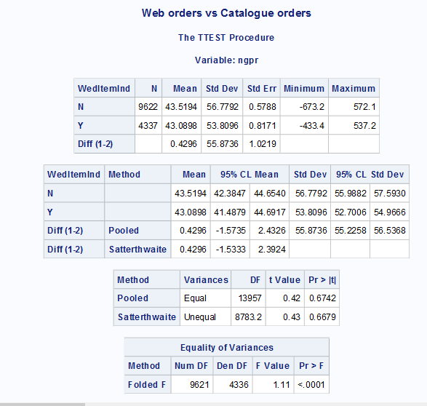
Idea 2: Encourage more Online orders

Slide 14
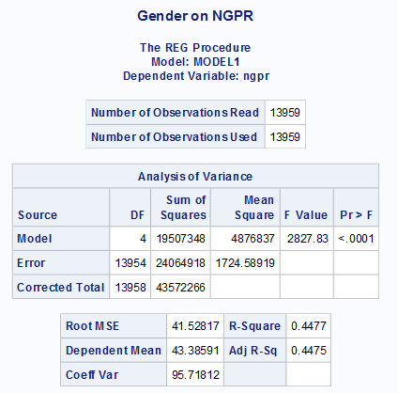
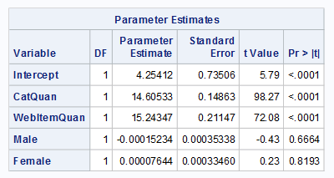
Regression using Gender

Slide 15
Idea 3: Encourage High-Quantity Shopping
High positive correlation between both Web Item Quantity and Catalog Item quantity with NGPR
Provide Package deals
Incentives for purchasing a certain monetary amount (free shipping, etc)

Slide 16
Insights
Continue advertising in states with higher total NGPR
Increase advertising in states with high populations relative to their NGPR (e.g. Texas)
Encourage more Online orders
Offer incentives to purchase more items at one time

